Slide 1

Birla Vishvakarma Mahavidyalaya
Vallabh Vidyanagar-388120
Subject : - EMBEDDED AND IOT SYSTEM DESIGN LABORATORY
Subject Code : - 3EL05
Project Name : - 2-Axis (X,Y) Face Tracking Gimbal
Guided by : - Prof. Anita Bhatt
Presented by : - Harsh Mehta (19EL083)

Slide 2


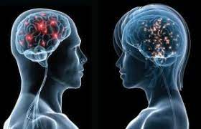
Problem Statements
Why Tracking ?
Riots
Surveillance at Inefficient Access of Technology in daily drills.
Human Phycological problems

Slide 3
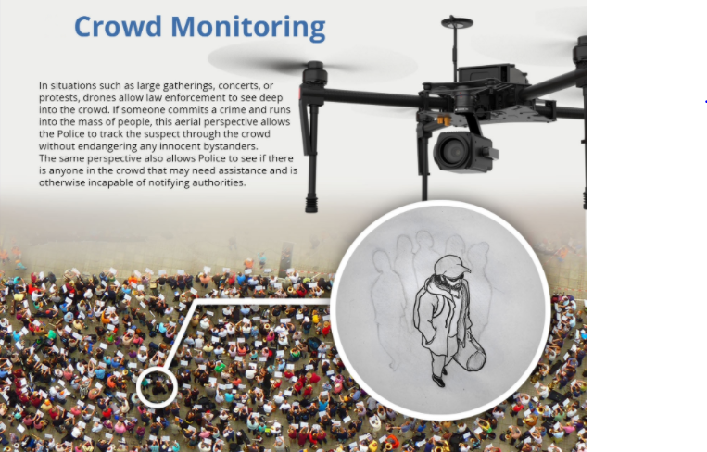
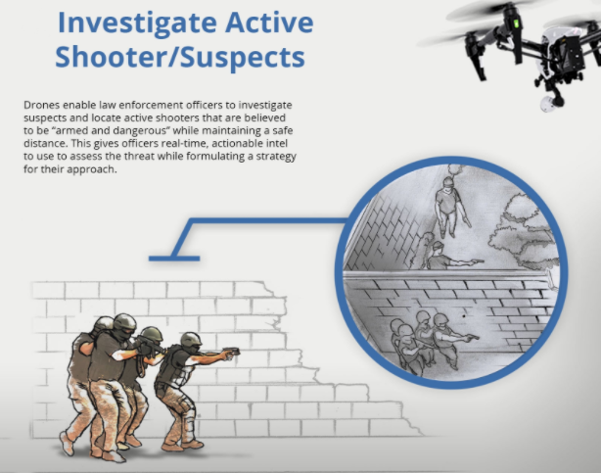
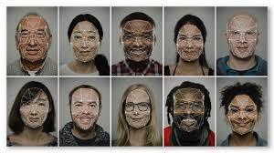
Solutions
Crowd Monitoring,
Non-lethal Weapon
Convoy Protection
Combat Assistance
24 hours face anlysis for patients

Slide 4
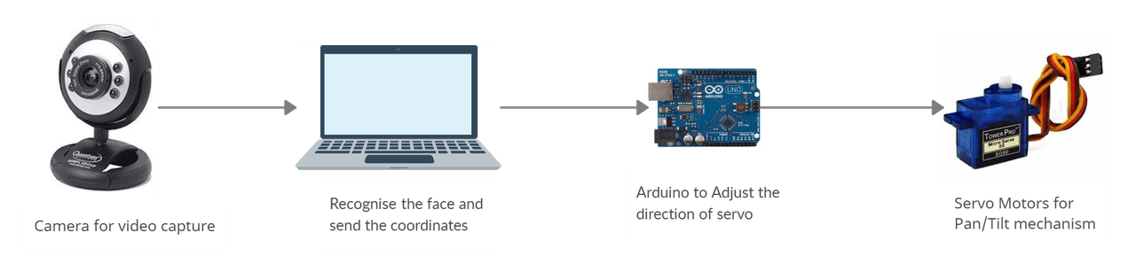
Working Flow-Chart
Start
Face Detection
No
Yes
Send the X,Y coordinates to the Arduino
Arduino rotate the servos according to the coordinate
End

Slide 5
HARDWARE COMPONENTS
Arduino Uno
Servo Motors
USB Camera
Bread Board
3D printed gimbal Components
Screw Driver
Jumper Wires
SOFTWARE COMPONENTS
Arduino IDE
PyCharm IDE

Slide 6
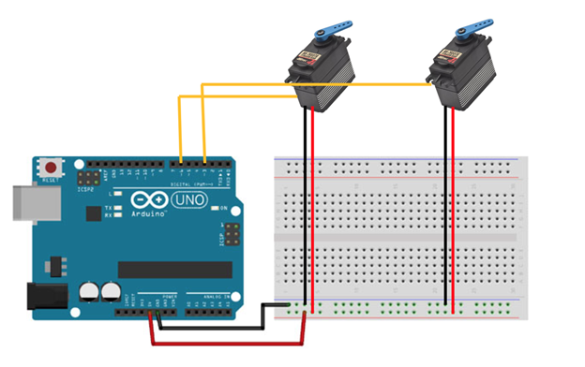
Schematic Diagram of circuit

Slide 7
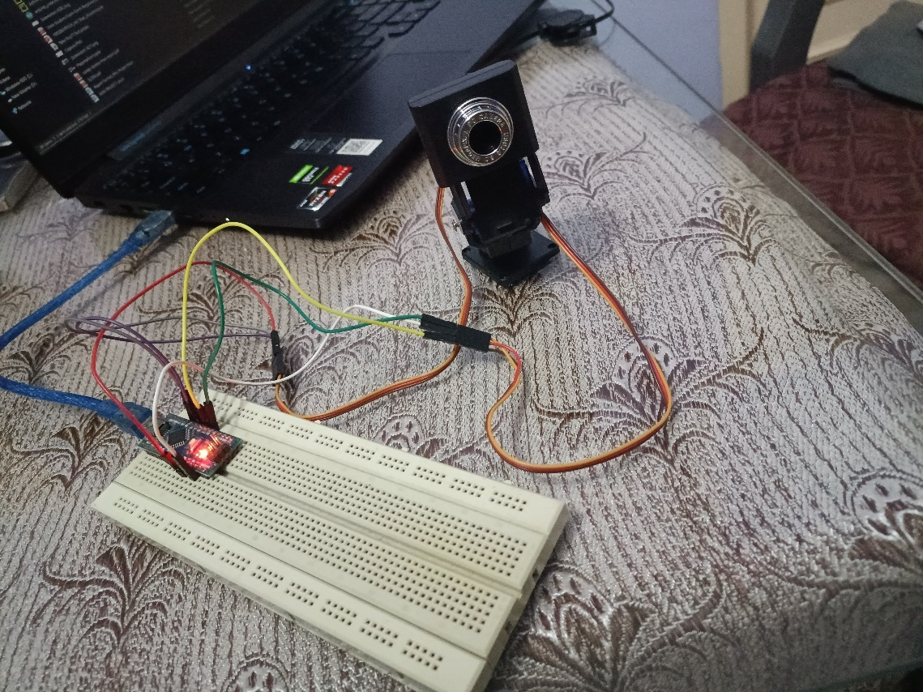
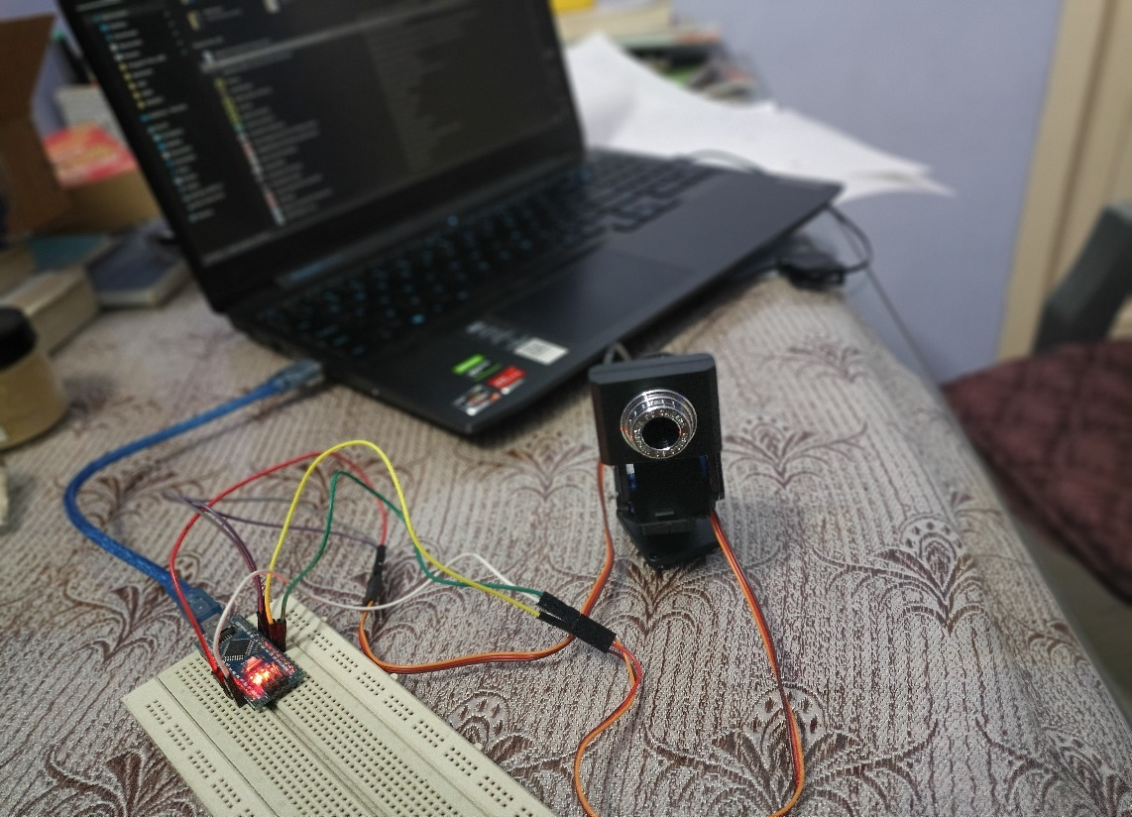
Hardware Implementation

Slide 8
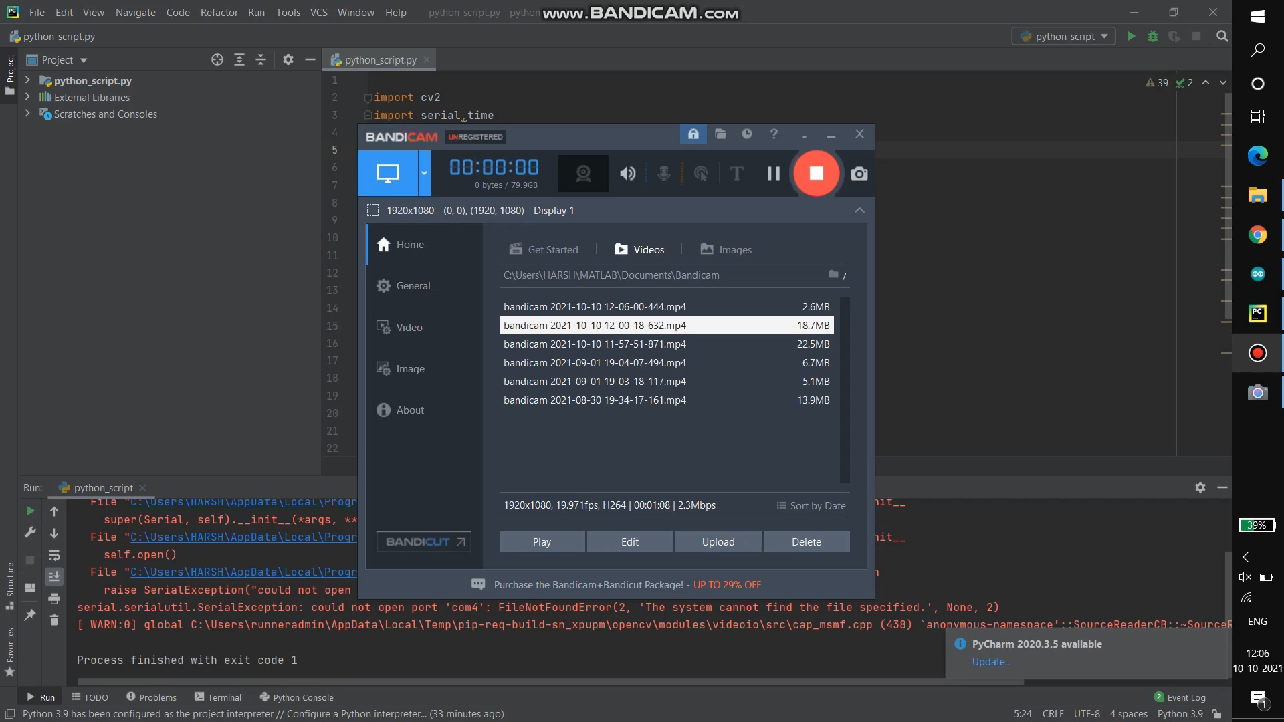
Real Time Hardware Implementation Video

Slide 9
APPLICATION
Person Monitoring in Riots
Easy to record the lectures (NPTEL Video Capturing)
Phycological facial expression analysis
Entertainment Industries

Slide 10
FUTURE WORK
After this project I have planned to implement 3rd axis (Z axis) within this project only. So from this my project running on 3-axis (X,Y,Z).

Slide 11
Thank you ☺

